Slide 1
Online Food Ordering App
Mahbuba Habib
ID : 1810026
Department :ECE
Session : 2018-19

Slide 2
CONTENTS
01.
Introductiono
02.
Software used
03.
Features of the app
04.
Screen shots and videos
05.
Advantage

Slide 3
Online Food Ordering App
An online food ordering system is a software resolution that enables the
customers to place orders through restaurant website, mobile app, or even
social media page. It manages all the information about Item Category,
Customer, Shopping Cart. Now-a-days , it has become a popular one.
According to a recent study published by the Interactive Advertising
Bureau and Viggle , approximately 69 percent of today’s consumers use
some sort of mobile device to order food online.

Slide 4



Software Used
IDE : Android Studio
Language : Java , XML
Database : Firebase

Slide 5
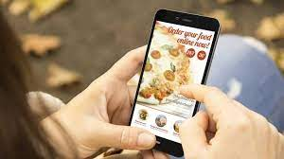
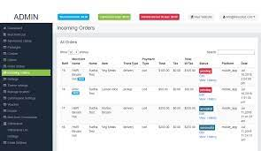

Features
In my food ordering app , there are basically 3 parts .
That are for
- Customers
- Admins
- Rider

Slide 6
Customers
* Registration / Log in
* Foods chosen between different category
* Number of pieces and confirmation message for adding in the cart
* Items that are ordered shown in the cart
* Information of address, phone and transaction id
* Order submit
* Contact owner if necessary

Slide 7
Admins
* Registration / Log in
* Claim admin submitting security code
* Order history
- List of orders
-List of items
-List of address and phone
* Add item
- Add in an existing category
- Create new category and add
* Requests owner to update / delete item

Slide 8
Riders
* Registration / Log in
* Claim rider submitting security code
* List of addresses with phone number and their unique code
* Google map by clicking the address
* Call using phone number
* Delete after completing delivery and it will clear from admin list also

Slide 9
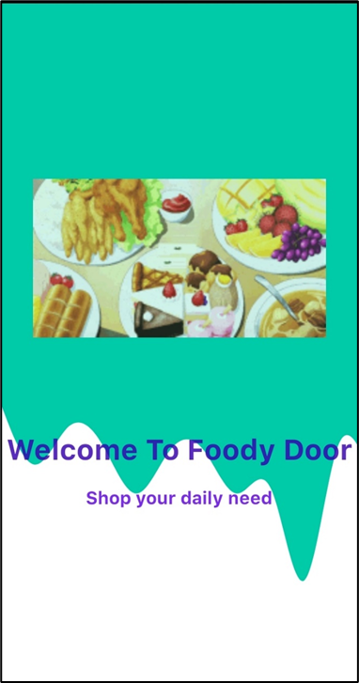
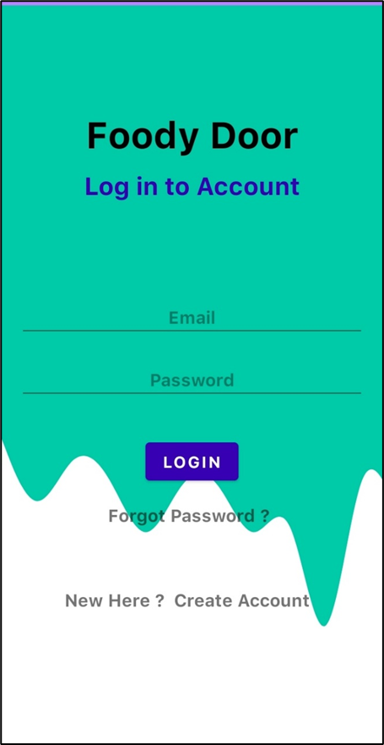
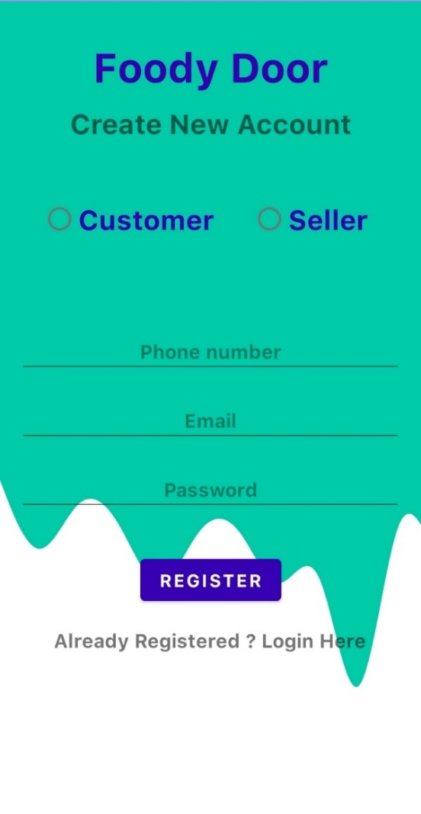
Screenshots
Splash Screen Log in Register

Slide 10
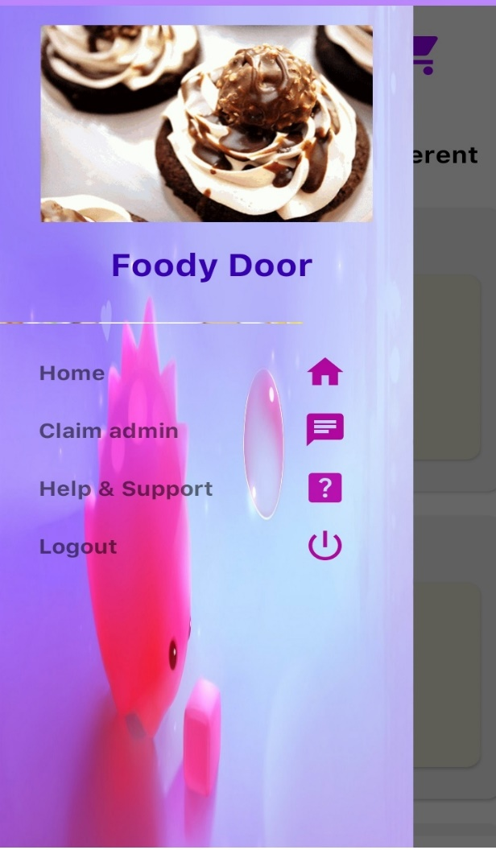
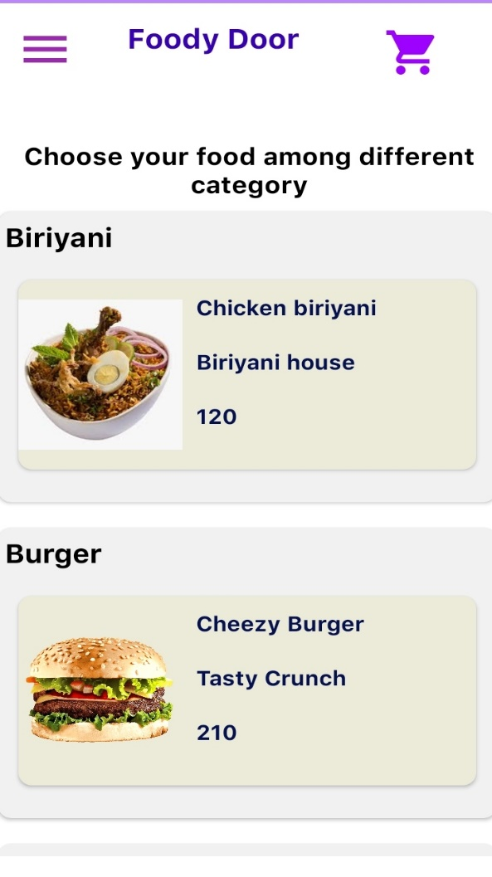
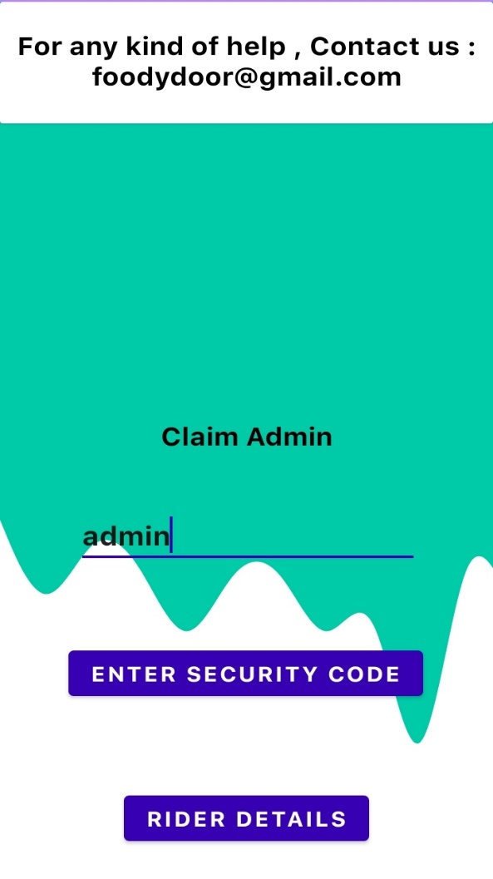
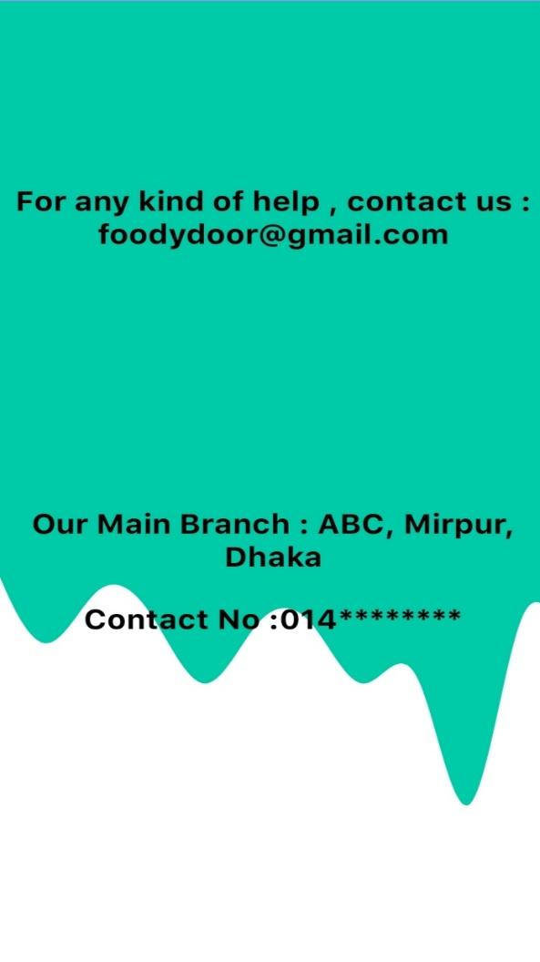
Navigation Bar and its connection

Slide 11

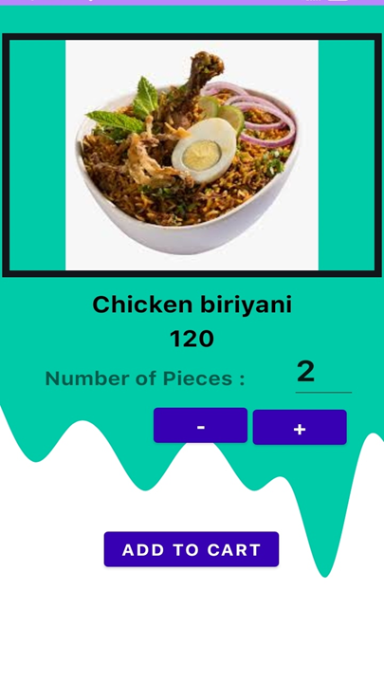
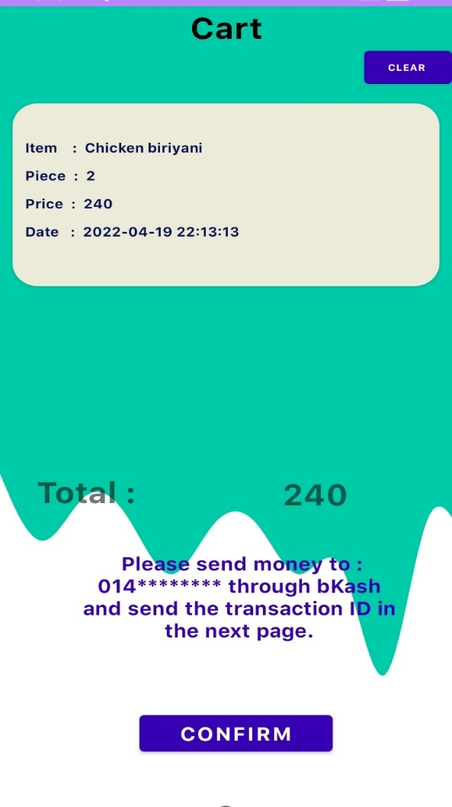
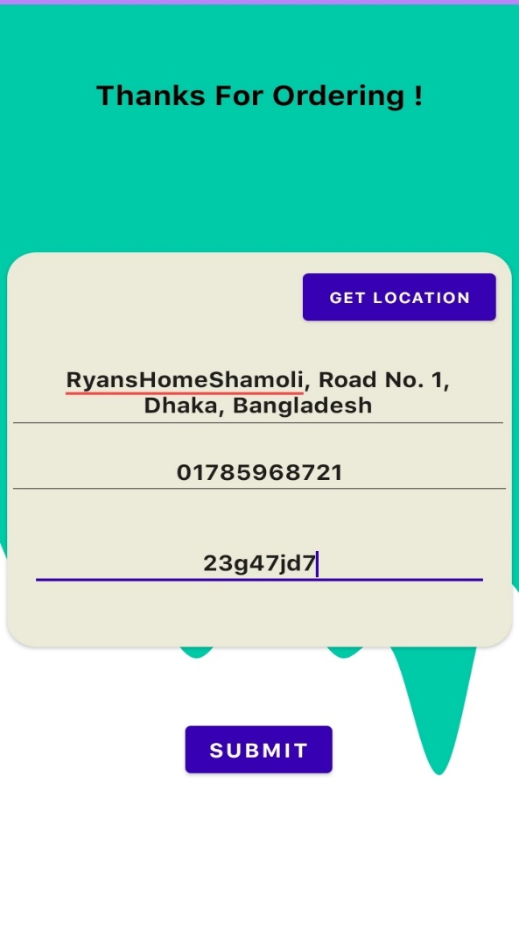
Customer Side Steps

Slide 12

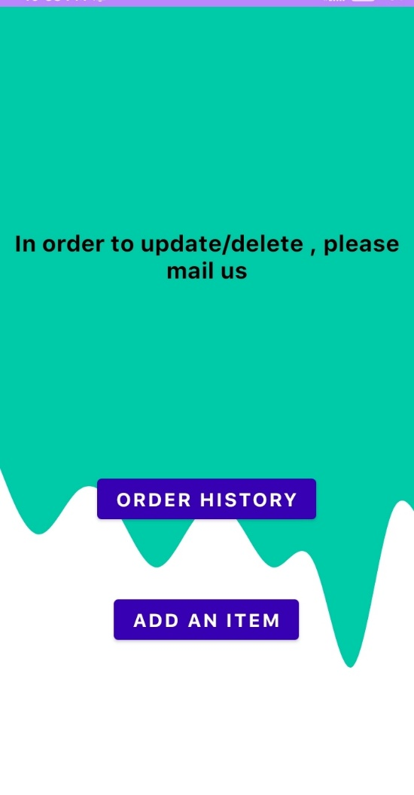
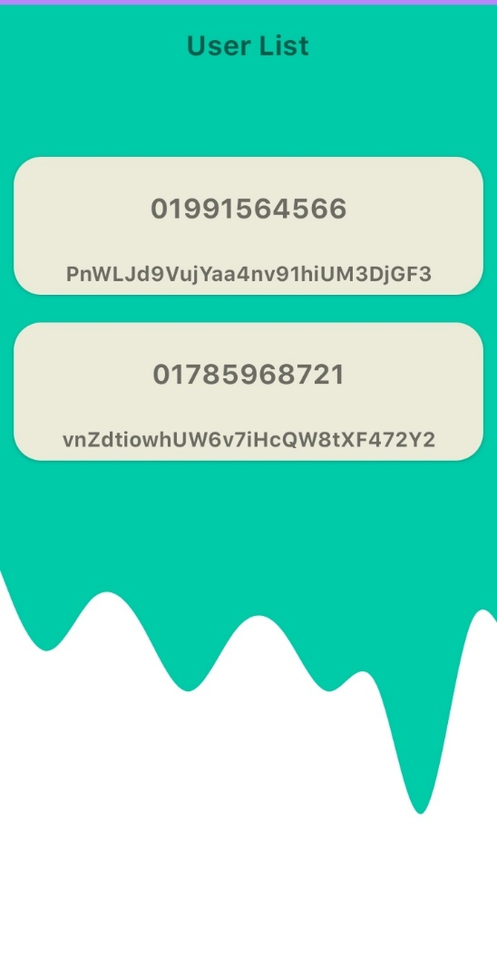
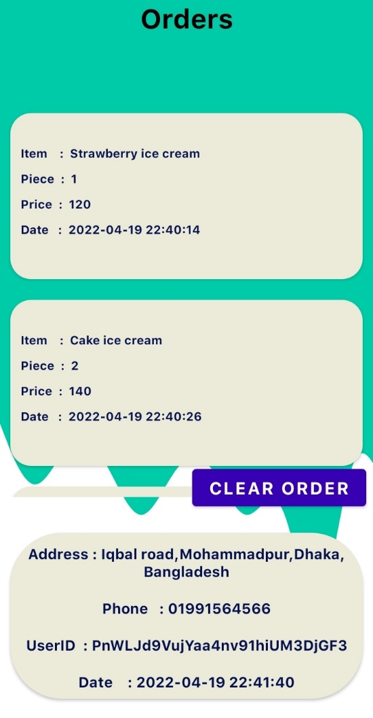
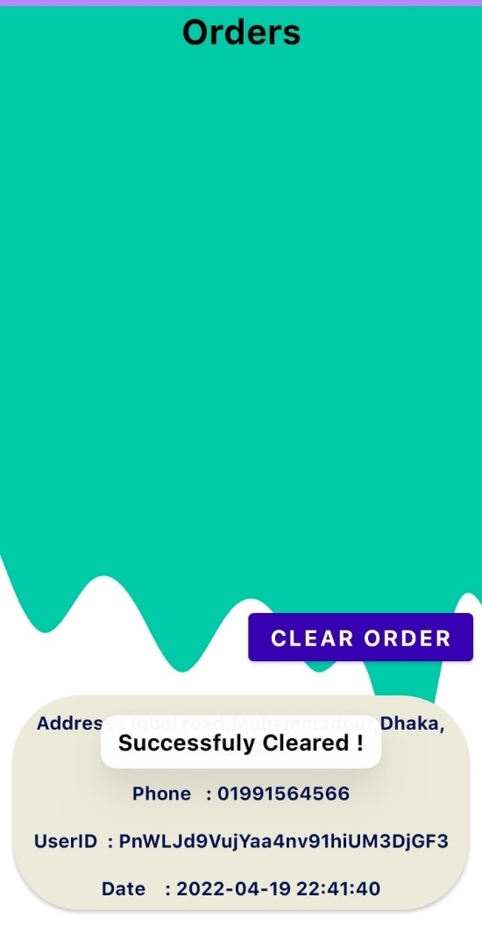
Admin Side Steps (Order history)

Slide 13
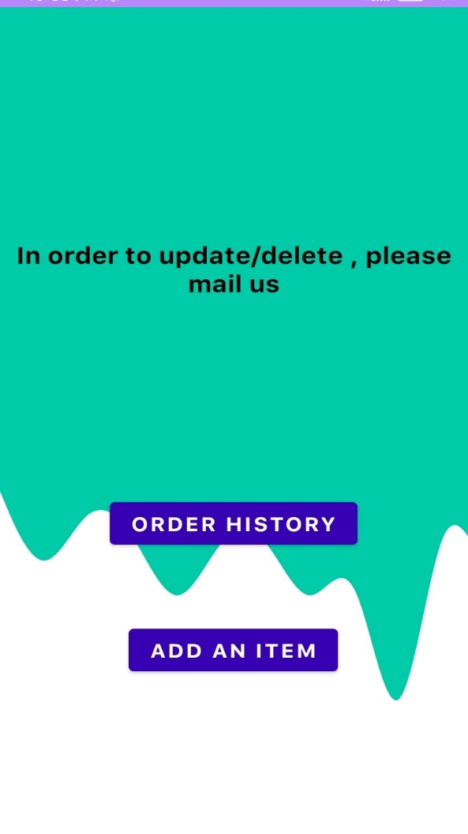
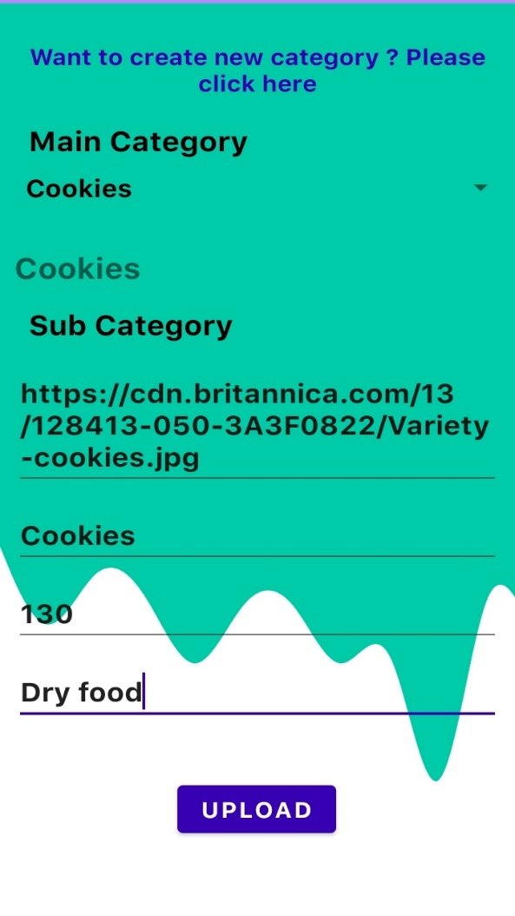
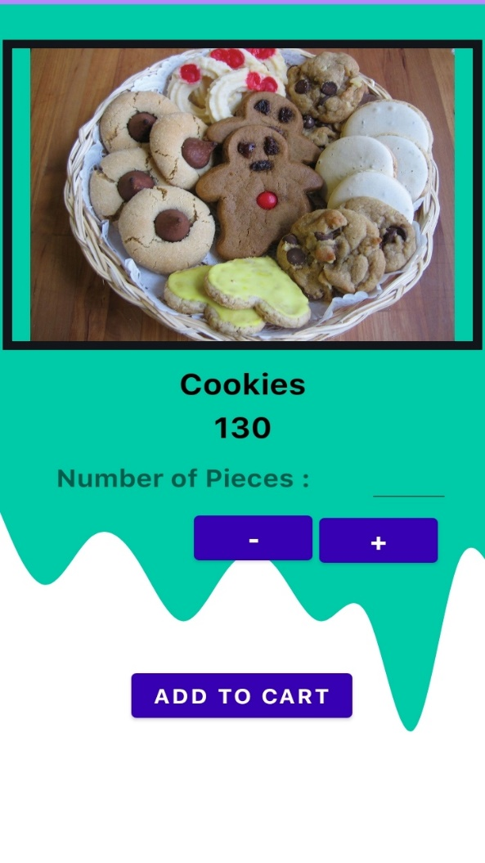
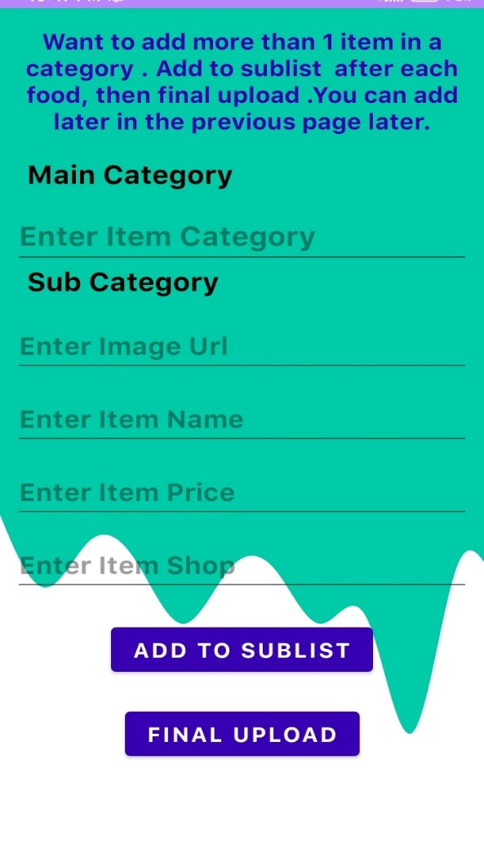
Admin Side Steps (Add Item)

Slide 14
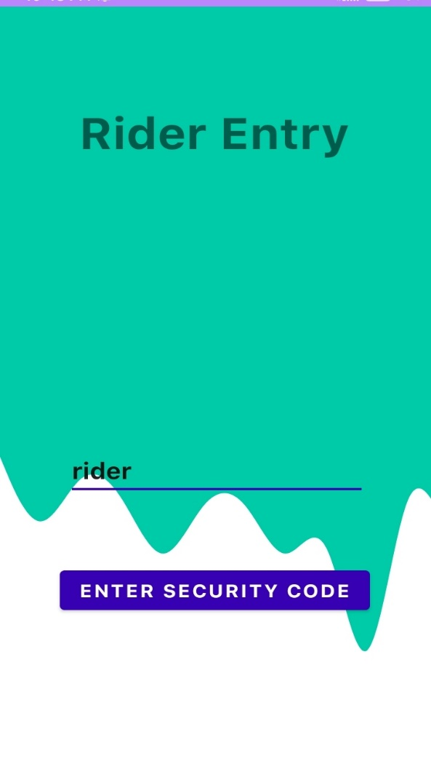
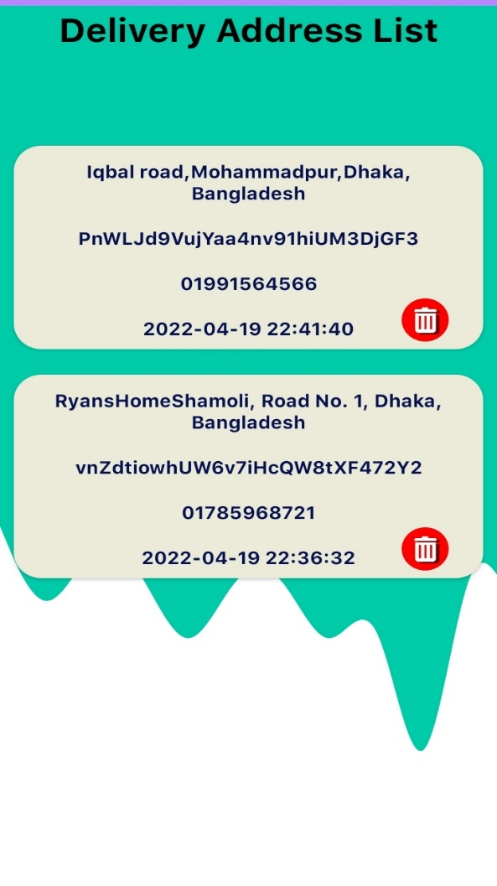
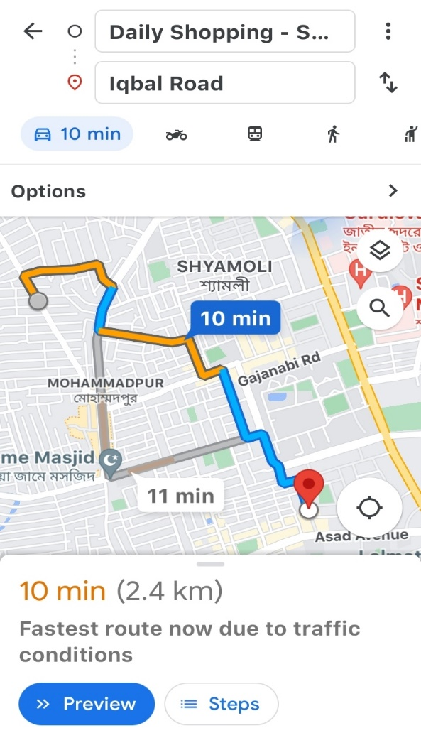
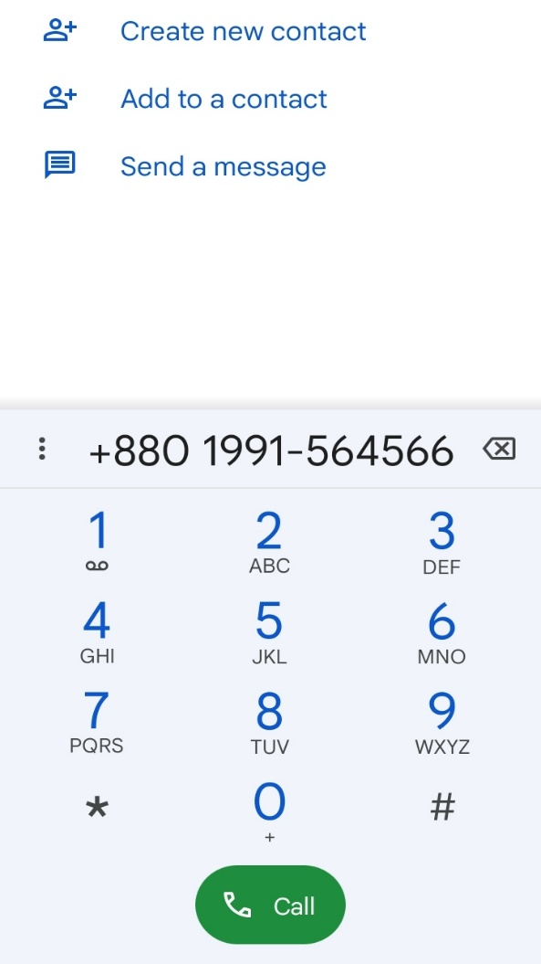
Rider Side

Slide 15
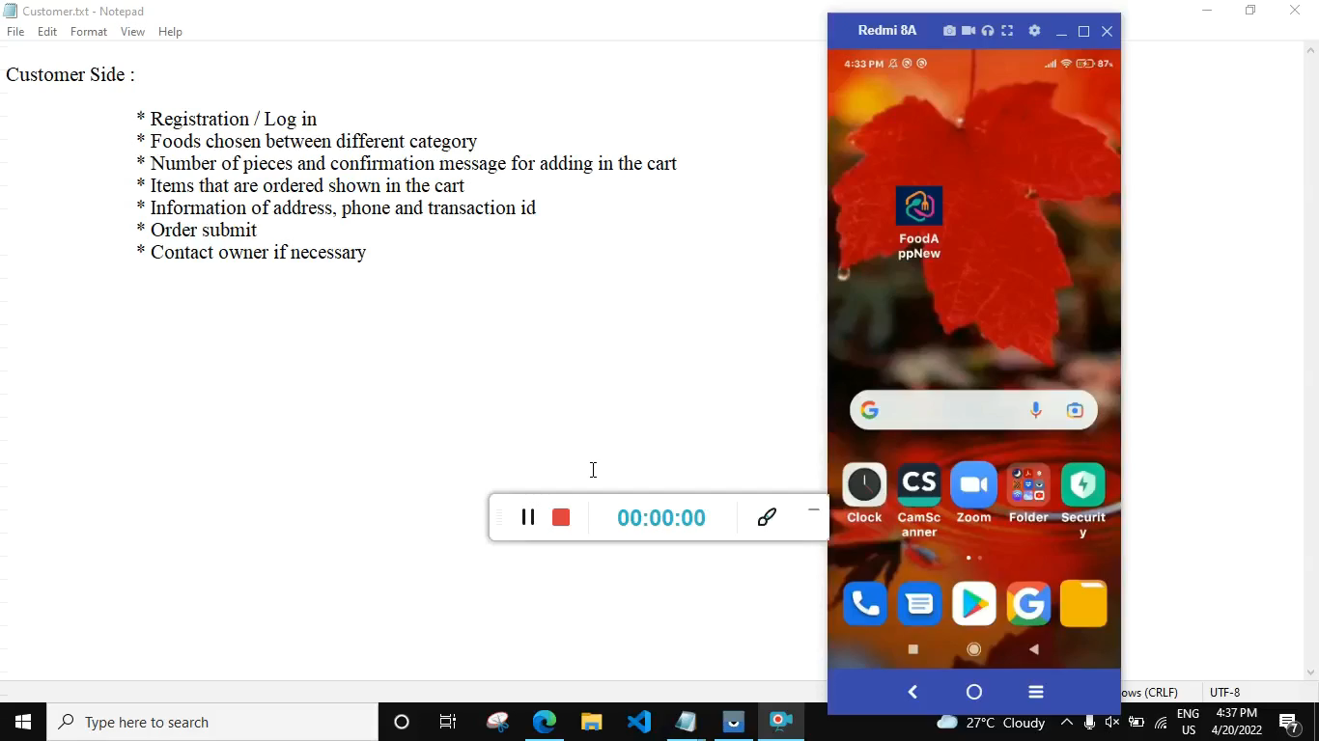
Video

Slide 16
Advantage
* Safer and healthier
* Exposure to new customers
* Online ordering is convenient
* Ordering process is fast, easy and comfortable
* Increased Marketing Opportunities
* More Control Over Customer Data
* Efficient customer and order management
* Greater reach
* Multiple ways to pay for the order

Slide 17
THANK YOU

